Slide 1
Alzheimer’s KNN Project
Benjamin Wang & Kevin Sun

Slide 2
01.
Introduction

Slide 3
Alzheimer’s Disease
A brain disorder that affects memory, thinking, and behavior.
The most common form of dementia, accounting for more than ⅔ of dementia cases in people aged 65 or older
The 6th in leading causes of death in the U.S.
Notes:
Kevin
approximately 6.5 million people in 2022 had dementia in the U.S.
By 2050, this number is projected to reach 13 million
No cure, only treatments to help with symptoms and delay the disease

Slide 4
Investigate the most significant factors that determine if Alzheimer’s patients are demented
This will help…..
Notes:
Kevin
By identifying the most significant factors, it will allow researchers for more effective development of targeted interventions to reduce the chances of patients to become demented, and is very important to the development of effective prevention, treatments, and cures.

Slide 5
02.
Dataset

Slide 6
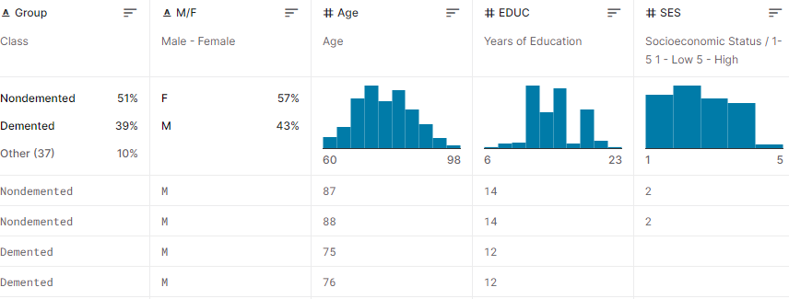

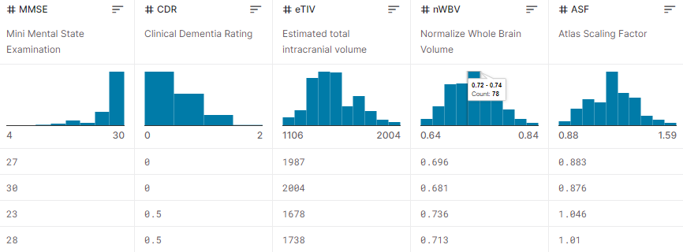
DATASET
Notes:
Kevin
Group: Nondemented, demented, or converted (nondemented converted to demented)
Gender: Male/Female Age
EDUC: Years of Education of patient
We decided not to use the socioeconomic status (SES)
MMSE: Mini Mental State Examination: 30 point questionnaire to measure cognitive impairment (25+ is normal, 21-24 shows mild signs, 10-20 shows moderate signs, Under 10 shows severe impairment)
Not using CDR (Clinical Dementia Rating)
eTIV: Estimated total intracranial volume: Volume of the cranial cavity (Space around the brain) and gives rough estimation of brain size
nWBV: Normalized Whole Brain Volume
ASF: Atlas Scaling Factor: The volume-scaling factor required to match each individual to the atlas target.

Slide 7
Why this Dataset
Complete Dataset
Consistent Dataset
Data Format
Data Variety
Notes:
Kevin
The dataset is mostly complete, with only a couple missing values and no mismatched values. And most of the missing values came from the Socioeconomic Status column, which we ended up not using, and only 2 came from data we wanted to use, so we didn’t have to delete many attributes from the dataset. The dataset was also free of inconsistencies at first glance. For example, there weren’t any obvious outliers, duplicates, errors in definitions, and inconsistencies with the formatting. The data was also in a .csv format, so that we could easily use it.
It also had lots of data variety, like not just data on the brain volume, and clinical dementia ratings, but also factors we wouldn’t usually associate with Alzheimer’s like gender, years of education and socioeconomic status.

Slide 8
DATASET Summary
 | Group | M/F | Age | EDUC | MMSE | eTIV | nWBV | ASF
Mean | 0.438 | 0.5687 | 77.01 | 14.61 | 27.34 | 1489.87 | 0.7295 | 1.19
STD | 0.4709 | 0.4959 | 7.66 | 2.88 | 3.68 | 174.99 | 0.0372 | 0.1365
Min | 0 | 0 | 60 | 6 | 4 | 1106 | 0.644 | 0.876
25% | 0 | 0 | 71 | 12 | 27 | 1358 | 0.7 | 1.1
50% | 0 | 1 | 77 | 15 | 29 | 1471 | 0.729 | 1.19
75% | 0 | 1 | 82 | 16 | 30 | 1598 | 0.756 | 1.29
Max | 1 | 1 | 98 | 23 | 30 | 2004 | 0.837 | 1.59
Notes:
Kevin

Slide 9
03.
Data Manipulation

Slide 10
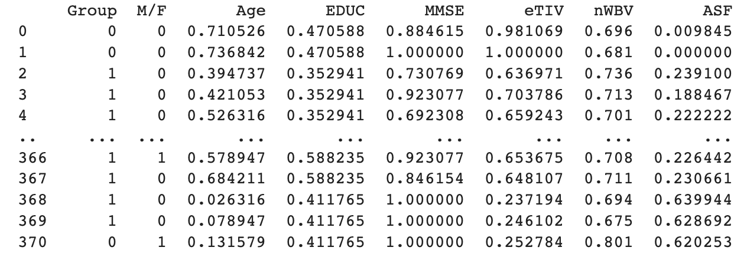
Data Cleaning
Removed “Converted” because the variable was unclear
Removed Categories SES and CDR because the data was too subjective and potentially bias
Removed attributes with missing values
Normalized all remaining data
Changed String values into Numerical values
Notes:
Kevin
Normalize all the data to a common scale (0-1; 0 is minimum & 1 is maximum) to prepare the data for machine learning.

Slide 11
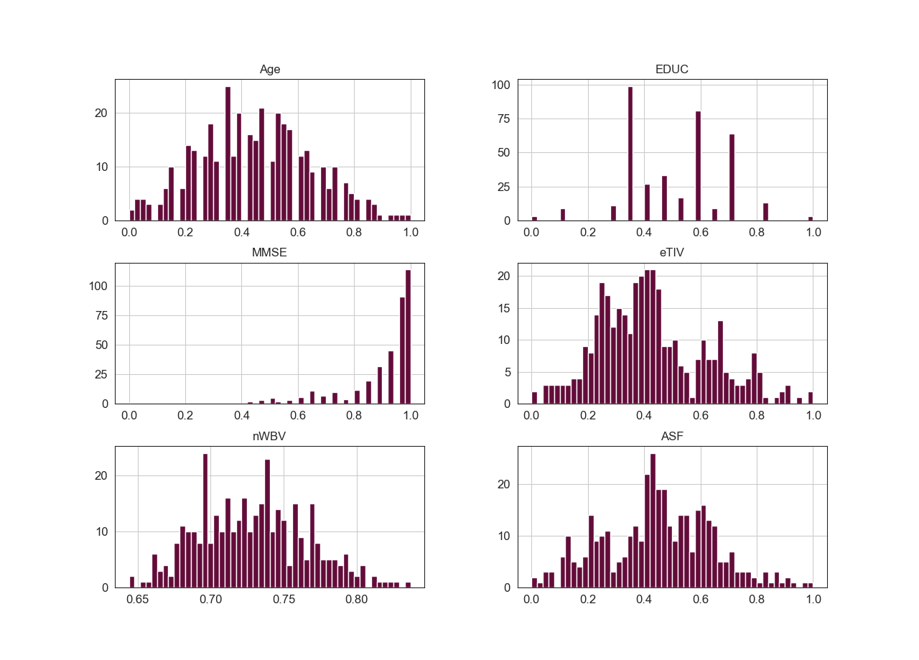
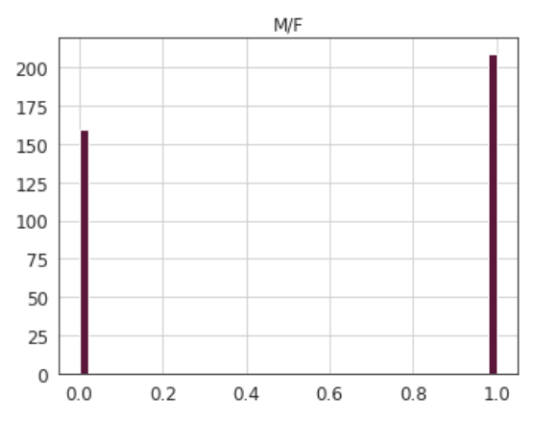
Notes:
Kevin
These are bar graph distributions of the normalized data we will be using. For some reference: 0.4 for age is around 70 years old. 0.4 for years of education is about 13 years. For MMSE, 1 would be the patient answering all 30 questions.

Slide 12
Notes:
Kevin
Estimated total intracranial volume

Slide 13
04.
Questions

Slide 14
Research Questions
What factors contribute most significantly to the patients’ degenerative Alzheimer's condition?
Does the volume of the brain correlate to the degenerative of an Alzheimer patient’s condition?
Notes:
Kevin

Slide 15
05.
K-Nearest Neighbor

Slide 16
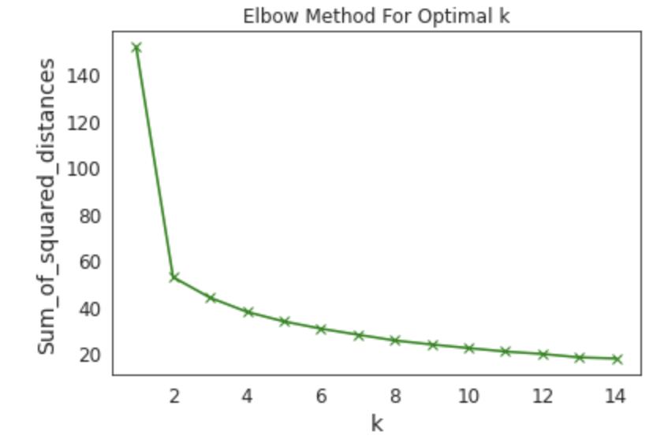
Elbow Graph & Optimal K-Value
# of Clusters | Silhouette Score
2 | 0.5778
3 | 0.4646
4 | 0.2635
5 | 0.2603
6 | 0.2523
7 | 0.2555
8 | 0.2605
Notes:
Kevin
For the optimal K-value, we looked for a higher silhouette score and a part of the elbow graph where it starts flattening out. So using both graphs, we decided to go 2 as the K-value.

Slide 17
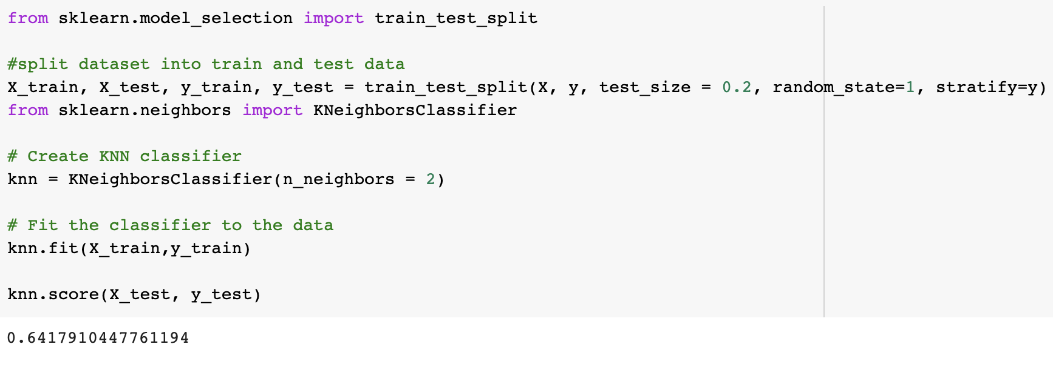
Notes:
Ben

Slide 18
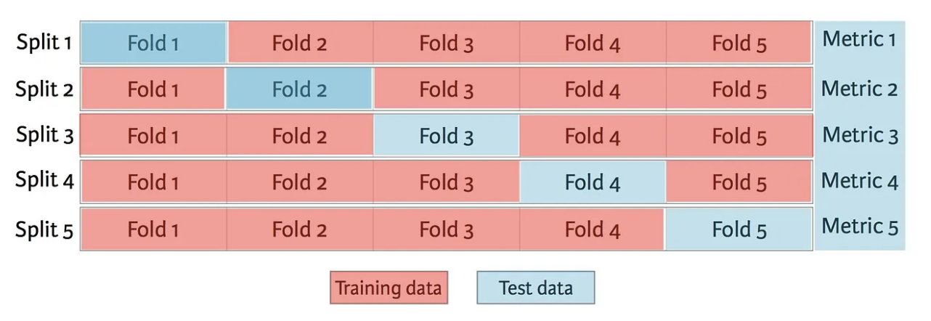
k-Fold Cross-Validation for Optimal K-Values
Notes:
Ben
The method we used previously was called the holdout method, whose results are heavily dependent on how you train and split your data. Cross-validation randomly split the dataset up into ‘k’ groups. One of the groups is used as the test set and the rest are used as the training set. Cross-validation gives the model an opportunity to test on multiple splits so we can get a better idea on how the model will perform on unseen data.
However if we use 5 k-Fold Cross-Validation we can see that our accuracy score outside of our own data set would only be 0.5748
By using Grid Search CV we can find the top performing n_neighbor values.

Slide 19
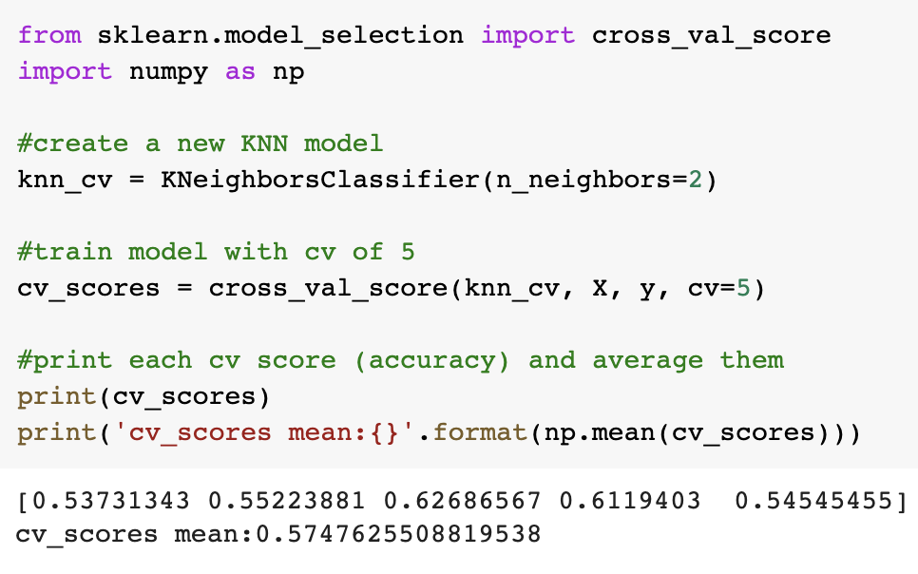
Notes:
Ben

Slide 20
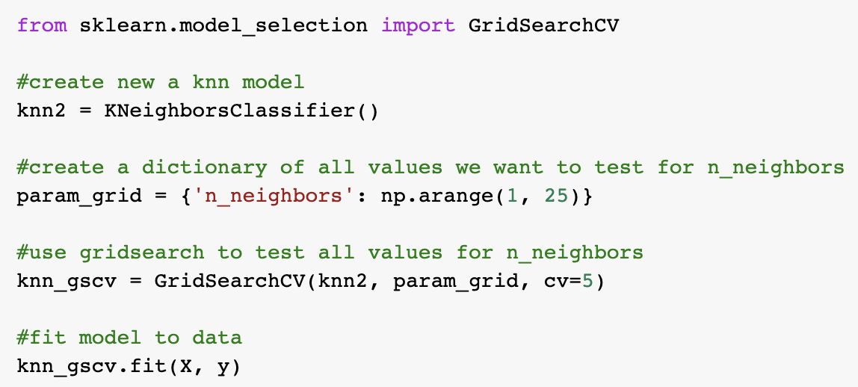
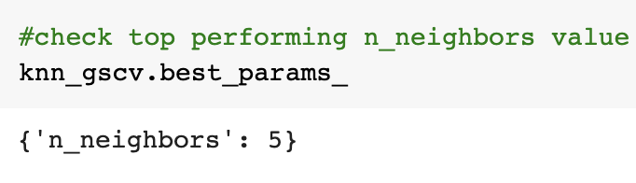
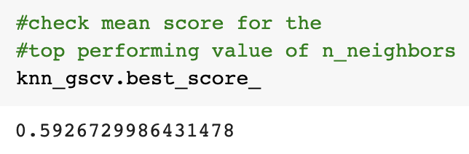
Notes:
Ben
GridSearchCV allows us to train our model multiple times on a range of parameters that we specify. This way, we can test our model with each parameter and figure out the optimal hyperparameter to get the best accuracy results.
kNN Score: 0.7

Slide 21
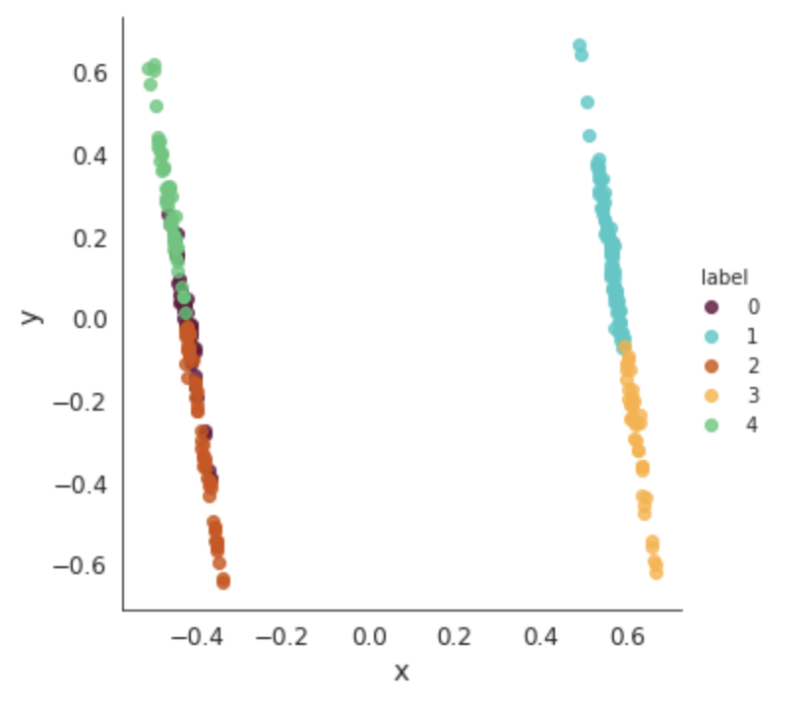
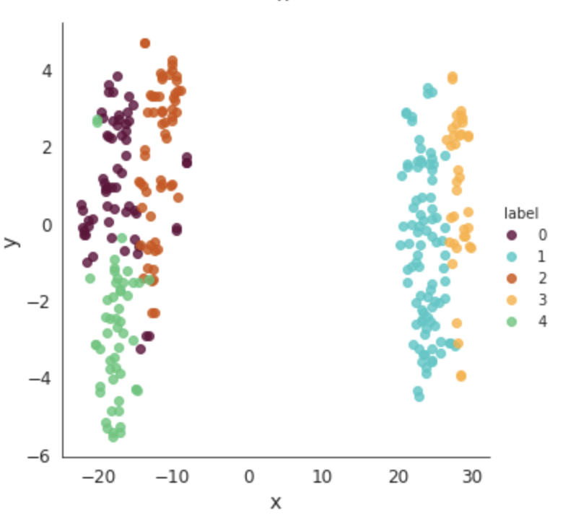
2D Visualisation of Alzheimer Patient Clusters
Principal component analysis (PCA)
t-Distributed Stochastic Neighbour Embedding (t-SNE)
Notes:
Ben
PCA will preserve large distances between points, while tSNE will preserve points which are close to each other in its representation.
PCA overall will try to prioritize saving the global structure which makes it harder to identify non-linear relationships, while tSNE will try to prioritize representing local structures .
PCA is a deterministic algorithm(produces same output each time) where as T-SNE is non deterministic in nature(may produce different output each time)

Slide 22
Cluster Summary
Cluster | 0
# | 62
Group | 0.387
M/F | 1
Age | 0.2568
EDUC | 0.4763
MMSE | 0.8424
eTIV | 0.3946
nWBV | 0.7489
ASF | 0.4655
Cluster | 1
# | 89
Group | 0.5843
M/F | 0
Age | 0.4137
EDUC | 0.4964
MMSE | 0.8933
eTIV | 0.3662
nWBV | 0.7183
ASF | 0.4952
Cluster | 2
# | 59
Group | 0.2712
M/F | 1
Age | 0.5616
EDUC | 0.5912
MMSE | 0.9374
eTIV | 0.5875
nWBV | 0.7357
ASF | 0.2894
Cluster | 3
# | 38
Group | 0.5789
M/F | 0
Age | 0.4813
EDUC | 0.5124
MMSE | 0.8694
eTIV | 0.7113
nWBV | 0.7186
ASF | 0.1882
Cluster | 4
# | 52
Group | 0.2885
M/F | 1
Age | 0.5111
EDUC | 0.4276
MMSE | 0.926
eTIV | 0.2028
nWBV | 0.7229
ASF | 0.692
Notes:
Ben

Slide 23
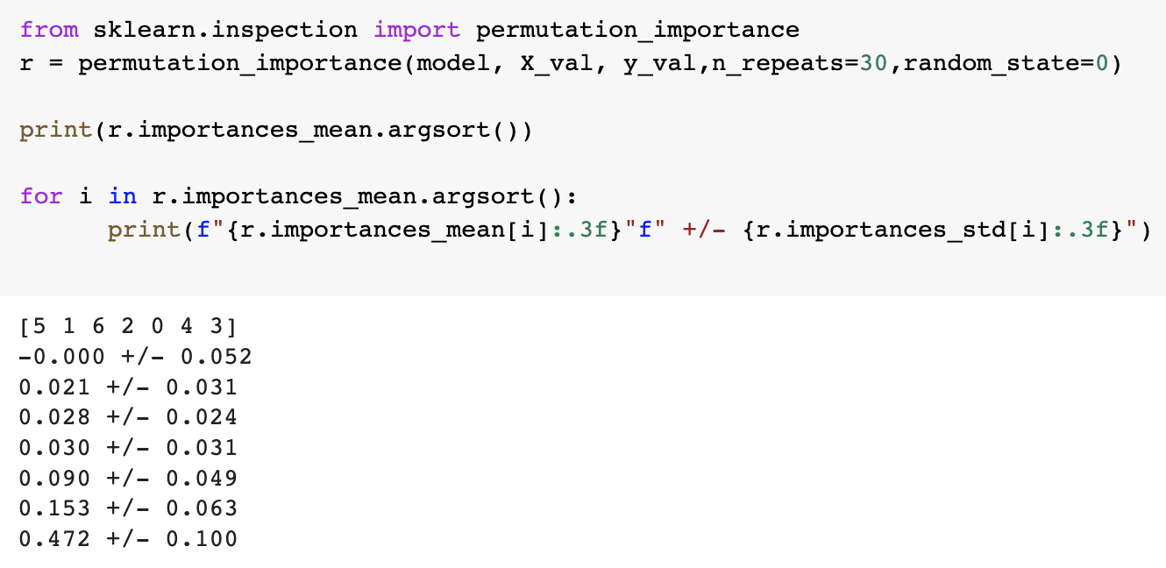
Using Ridge Regression to Determine Feature Importance
Notes:
Ben
Using Ridge Regression to determine feature importance with sk.learn permutation importance, since this was most useful for non-linear estimators.
Since Permutation Importance is model agnostic it can be used on any machine learning mode
Ridge gives biased parameter estimates in order to lower the variance of those estimates. This is ideal for collinearity problems.

Slide 24
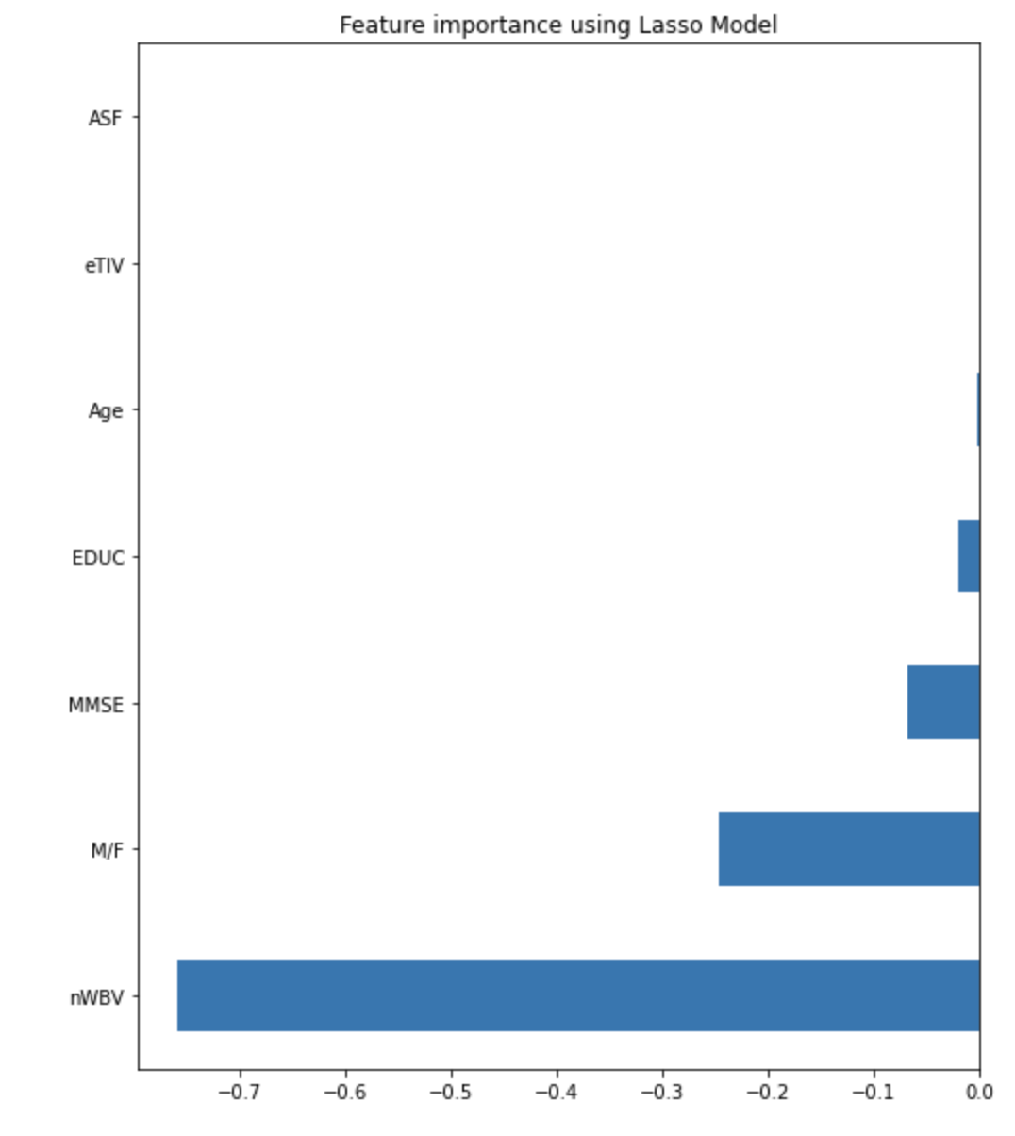
Lasso Regression for Feature Importance
Notes:
Ben

Slide 25
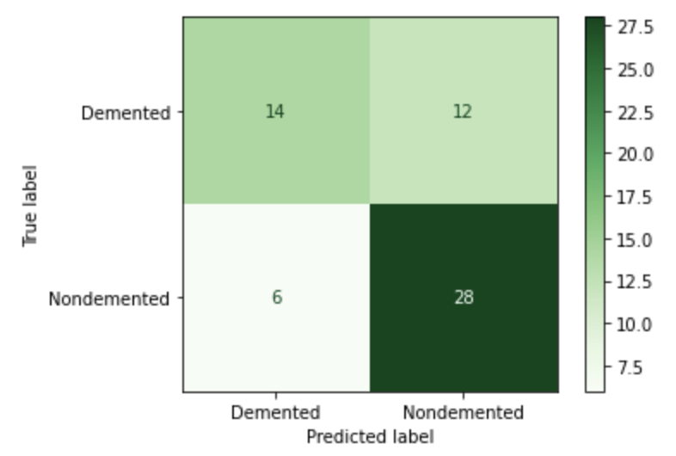
Feature Importance & Accuracy
nWBV | Age | ASF | EDUC | M/F | eTIV | MMSE
-0 +/- 0.052 | 0.021 +/- 0.031 | 0.028 +/- 0.024 | 0.03 +/- 0.031 | 0.09 +/- 0.049 | 0.153 +/- 0.063 | 0.472 +/- 0.1
Accuracy with Holdout Method: 0.7
Accuracy with Cross-Validation: 0.5926
Notes:
Ben
To answer our first question, the factors most important to the degenerative condition. The most significant factor is the Mini Mental State Examination. Some other significant factors according to our data are the Estimated total intracranial volume, And close behind it, gender. The gender factor is high, and we believe the reason for this is likely because of the skewed data: there are 14% more females than males in our data, and also because woman do have a greater risk of developing dementia. They comprise of 2/3rds of Alzheimer’s patients.
Kevin
To answer the second question, whether the volume of the brain correlates to the degenerative condition, according to our results, it is the least significant factor out of the ones we studied, sitting at 0.03. This is likely because, looking at our data, the normalized brain volume standard deviation is 0.0372, and according to National Center for Biotechnology Information, the standard deviation of brain volumes for both males and females is 0.05. I think a better kind of data for brain volume is to look at how much volume the brain was reduced by, because everyone’s brain volumes are different.

Slide 26
06.
CONCLUSION

Slide 27
Conclusion
Mini Mental State Examination, Estimated total intracranial volume, and Gender were the most significant factors
More effective Diagnostic tools + Screening methods
More target and effective interventions and treatments
Notes:
Kevin
The Mini Mental State Examination, Gender, and Estimated total intracranial volume were the most significant factors in determining if a patient is demented.
To recall what the Mini Mental State Examination is, it’s basically a screening tool that measures cognitive impairment, and our findings suggest that this tool may be useful in deciding whether individuals have dementia.
The Estimated total intracranial volume basically measure the brain’s volume, so our findings also suggest that changes in this areas are also important in whether the patient has dementia and could be targeted and focused on in treatments.
By identifying the significant factors that cause the development of dementia, more effective diagnostic tools and screening methods that can help identify individuals who have dementia can be created. More targeted and effective interventions and treatments can also be developed, aiming at preventing or delaying the dementia of Alzheimer's disease.

Slide 28
THANK YOU!

